Slide 1
Click to Start Presentation

Slide 2
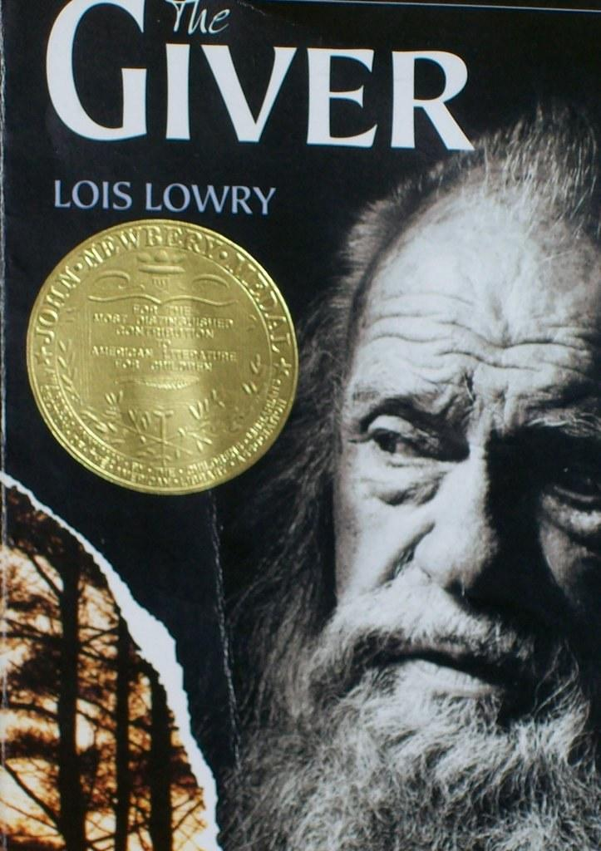
The Giver
By Lois Lowry
Notes:
Dedicated title page

Slide 3

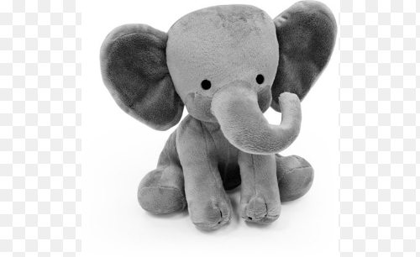
The Giver
Jonas lives in a world without freedom, feelings, colors, or animals. Jonas decides to escape with a baby named Gabriel who keeps Jonas company.
Genre: Sci-Fi
By Lois Lowry
Notes:
The Giver, a science fiction book by Lois Lowry, is about a boy named Jonas who lives in a world without freedom, feelings, colors, or animals. Jonas decides to escape with a baby named Gabriel who keeps Jonas company. Their world is so strange and restricted that they don’t even know what an elephant is!

Slide 4
Main Characters
Jonas
The Giver
Gabriel
Side Characters
Lily
Mother
Father
Fiona
asher
Notes:
The main characters in The Giver are:
Jonas
The Giver
Gabriel
Some minor characters are
The members of Jonas’ family unit
Jonas’ friends

Slide 5
Jonas, the protagonist in this story, lives in a world where there is no freedom. The government controls what job you get, who you marry, and they even decide whether or not they let you become a family unit! Jonas learns that there is another way to live, one that allows feelings, when he is selected to be the next person to hold all of the communities’ memories of wisdom.
Notes:
Short story synopsis.
Jonas, the protagonist in this story, lives in a world where there is no freedom. The government controls what job you get, who you marry, and they even decide whether or not they let you become a family unit! Jonas learns that there is another way to live, one that allows feelings, when he is selected to be the next person to hold all of the communities’ memories of wisdom.

Slide 6


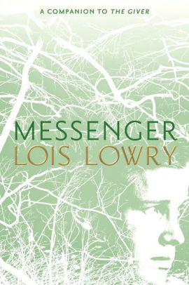
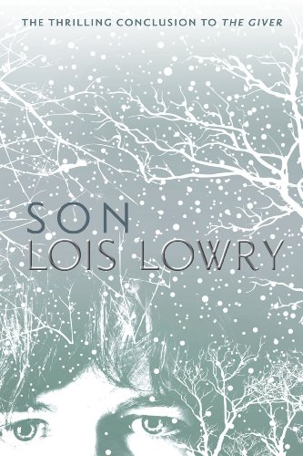

Other Books in this series
Gathering Blue
Messenger
Son
Notes:
The other books in the Giver Quartet series are:
Gathering Blue
Messenger
Son
I have also included a picture of the cover of The Giver, quartet edition

Slide 7
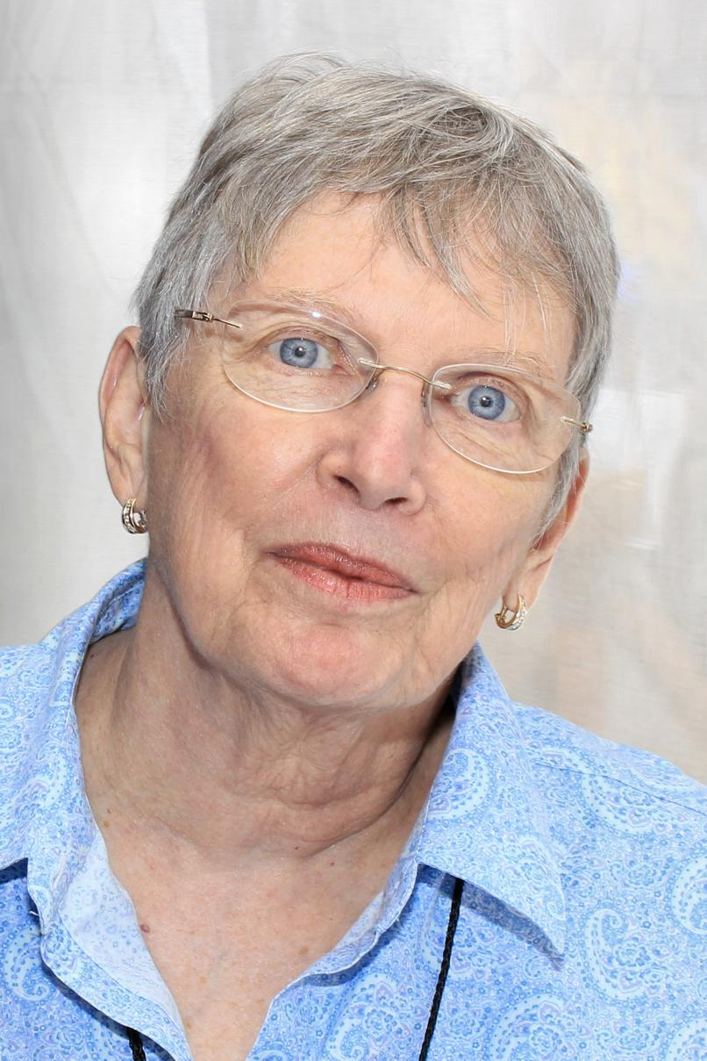

Meet the author
Lois Lowry is a children’s writer, and has won numerous Newbery Honor Awards on many of her books, including The Giver and Number the Stars. She has also written many picture book series, including Gooney Bird and Anastasia.
Lois Lowry
Notes:
This is the slide with the image in a shape.
Lois Lowry is a children’s writer, and has won numerous Newbery Honor Awards on many of her books, including The Giver and Number the Stars. She has also written many picture book series, including Gooney Bird and Anastasia.
Click to show the cover of Number the Stars.

Slide 8
Quick Stats
Pricing: (Amazon Prices) New - $15.99 Used - $9.99
Recommended age for reading this book: 12+
Quick Stats about the book
Notes:
Sales info and Historical Proceeds are unavailable for this book.
Pricing: new - $15.99 old - $9.99
Recomend age for book: 12+

Slide 9
Thank you for listening!
If you have any questions, feel free to ask!
Notes:
Thank you for listening!
Answer questions

Slide 10
End of slideshow, press esc to exit

